Slide 1
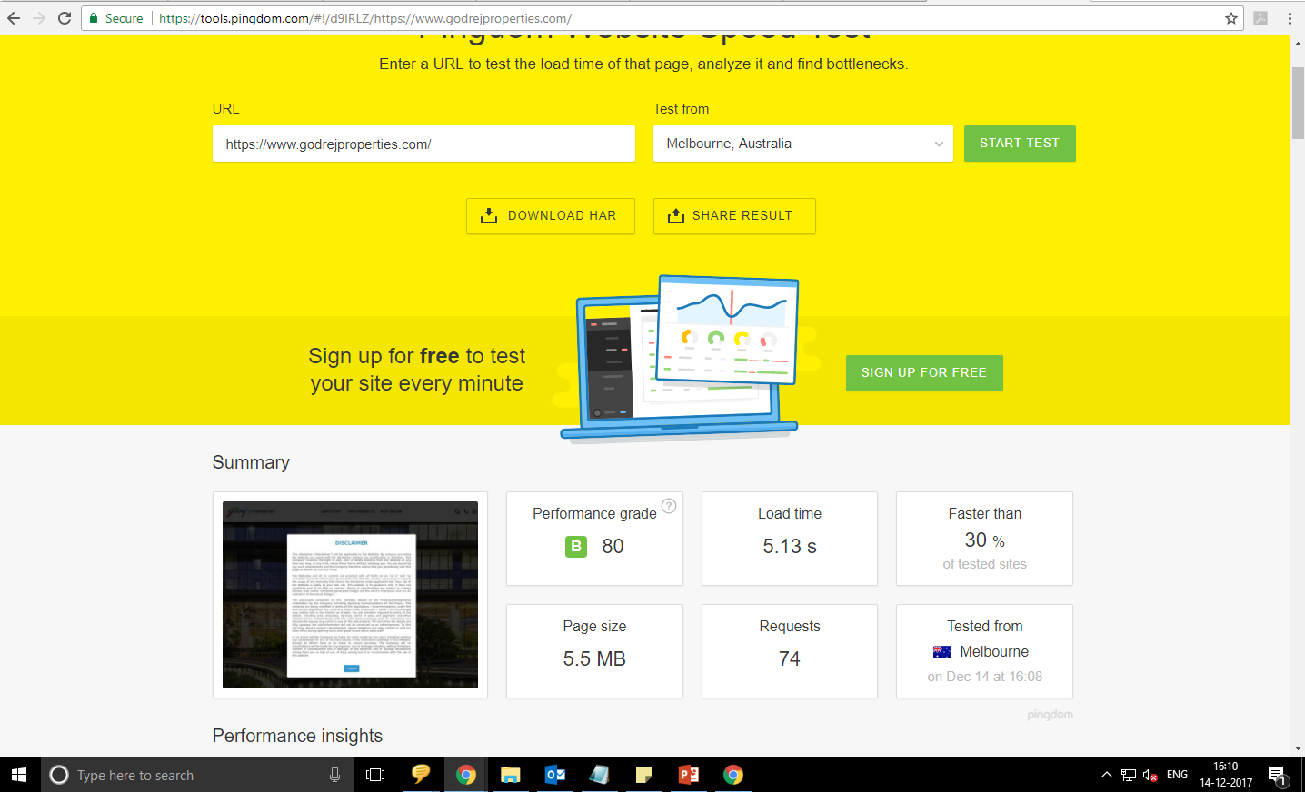
Pingdom Tool

Slide 2
Speed testing with Pingdom Tool tested from Melbourne
Page size is 5.5 MB
Load Time is 5.13 Sec
Performance grade is 80

Slide 3
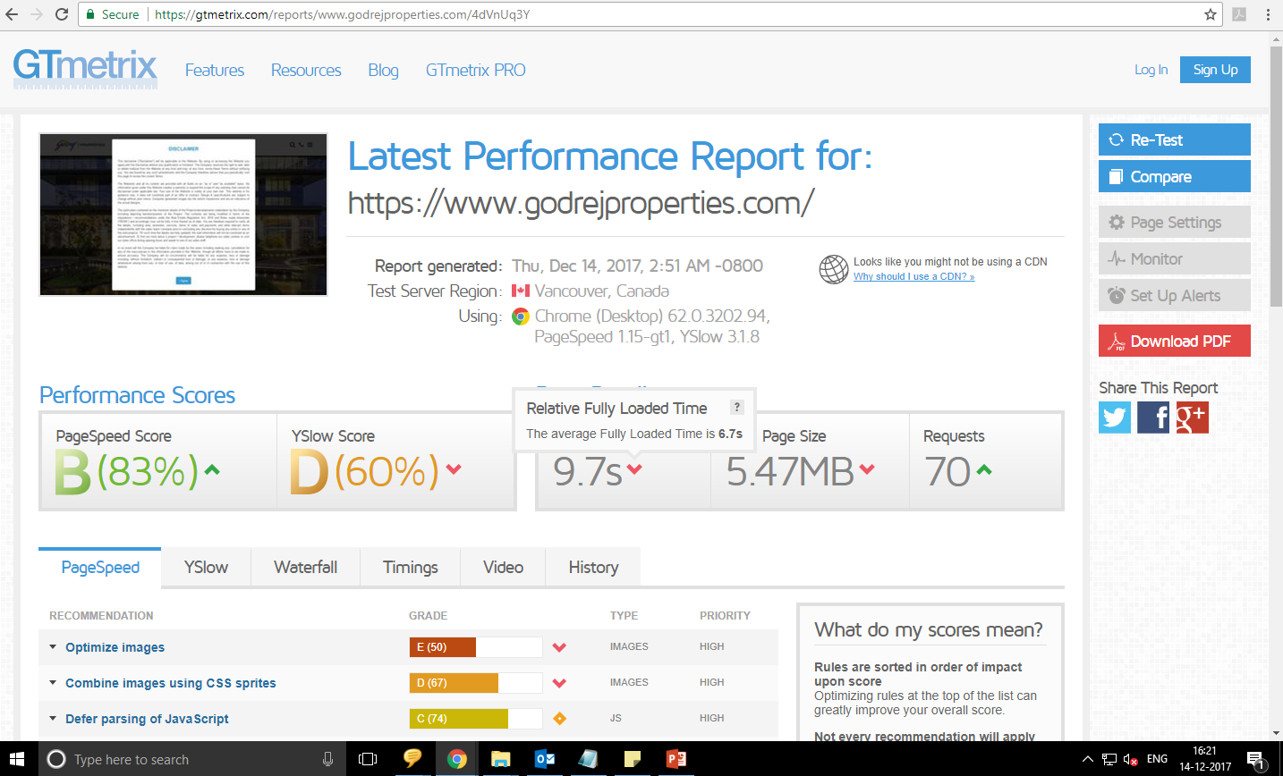
GT Matrix Tool

Slide 4
Speed testing with GT Matrix Tool
Page size is 5.47 MB
Average Fully Load Time is 6.7 Sec
Performance grade is 83

Slide 5
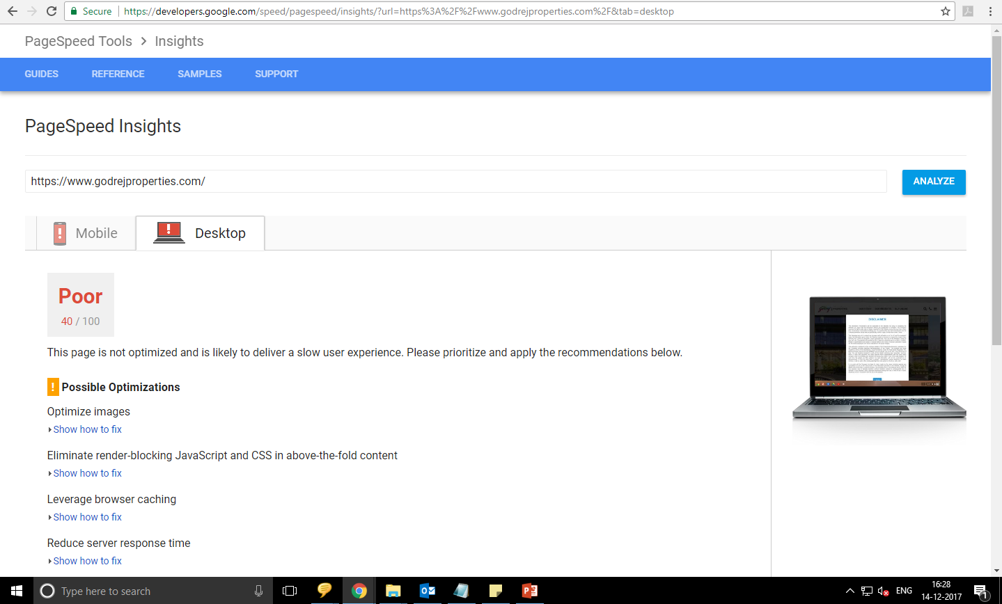
Google page insight Desktop View

Slide 6
Google page insight showing low score 40/100

